Slide 1
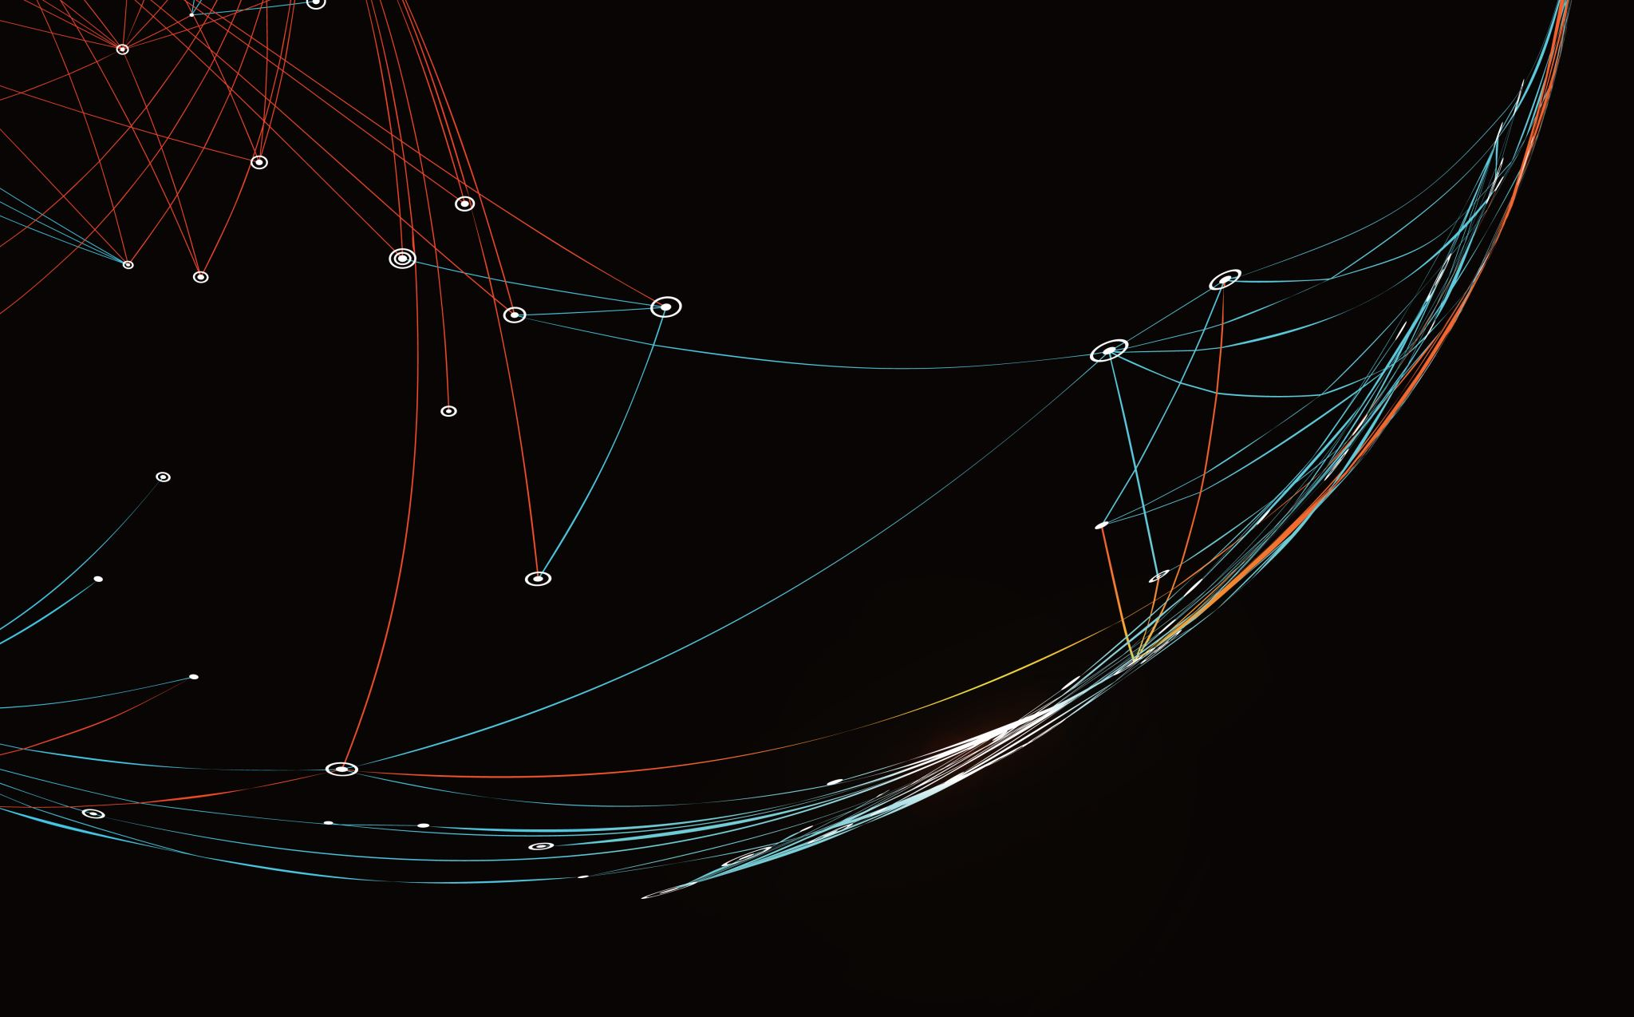
Security Assessment and Risk Management
Week 6 –Tools and Contracts

Slide 2

Put it to Work
Your organization is attempting to decide support for their web app.
Determine a recommendation based on risk for desktop browsers.
Determine a recommendation based on risk for mobile browsers.
Vague premise is intentional. Ask for what you need. Find what you can.

Slide 3
Security Reviews
No one rolls their own if they can avoid it.
Standardization isn’t a bad thing, but beware the wise words of the elders: “If everyone jumped off a bridge, would you do it too?”
Many products are niche – they do one thing well (or passably) and make their money off supporting that niche.
Some products end up at organizations because it’s what people know, or know someone there, were schmoozed by salespeople, etc.

Slide 4
A Case of Domain Name Theft
Kremen v. Cohen
In 1994, Gary Kremen registered the domain SEX.com with an official registrar – Network Solutions.
Stephen Cohen later sends a letter to Network Solutions, forging it to look like it’s coming from Kremen’s company – Online Classifieds. The letter claims that the company had to let Kremen go suddenly, and they need to change their administrative contact for the website.
Network Solutions transferred it without question to Sporting Houses Management, Inc. – a shell company owned by Stephen Cohen

Slide 5
A Case of Domain Name Theft
Kremen v. Cohen
Gary Kremen becomes aware of the theft and contacts Network Solutions who refuse to reinstate him as administrative contact without a court order.
Gary Kremen sues Cohen as well as Network Solutions
The court orders Cohen to return the domain name to Kremen, but rules Network Solutions is not at fault because a domain is “intangible” – not a physical good that can be possessed, thus not making them liable (by a process known as conversion.)
On appeal, the California Supreme Court ruled Kremen DID have a conversion case against Network Solutions because of Kremen’s prior ownership of the domain name.

Slide 6
Shrinkwrap
Let’s explain quickly what a Shrinkwrap license is…
You probably have no idea how many contracts you have signed in your life without even knowing it. These contract start out, “By opening this package…” or “By using this product…” or “By installing this service…” and you just don’t pay attention.
These are shrinkwrap licenses, and they are the primary way copyright holders protect their intangible assets today. This include Terms of Service (ToS) and End User License Agreements (EULA)

Slide 7
Clickwrap
Let’s explain quickly what a Clickwrap license is…
An extension of this is the Clickwrap (or Click Through) agreement, where you press Agree to accept the terms and conditions. This is actually legally binding, same a signature or typing your name to an email (or at least it has not been sufficiently challenged to prevent it being consider such.)
Another variation is the Browsewrap agreement, which users must agree to before using a website. This was most visible after the implementation of GDPR where every website on the Internet suddenly had a pop-up notifying users that their Privacy Policy had changed.

Slide 8
Security Review
Verify Contracts – Contract Owner shall identify contracts that may access USG data or that may provide systems, products, or services.
Determine Risk Levels – Based on the type of data or service, the Contract Owner shall assess the overall level of risk associated with using the product
If you determine the risk level is high enough ow arrant scrutiny, move on…

Slide 9
Security Review
3. Verify Contract Language –Ensure that the new contract, or contract renewal, has been reviewed so that the contract includes language appropriate for the designated risk level.
4. Cybersecurity Awareness Training –Ensure the contracts include language to address supplier management and staff annual cybersecurity awareness training.
5. Review Cyber-Insurance Needs –Determine if a need exists concerning cybersecurity insurance.

Slide 10
Security Review
6. Request/Review Supplier Documentation – Ensure supplier compliance is documented or otherwise addressed in the contract. Examples of appropriate documentation could include a SOC report, an assurance provider's assessment of the supplier’s cybersecurity protocols, etc.
7. Review Supplier’s Cybersecurity Controls (Data Assets) – The Contract Administrator must have the supplier’s documented processes for the assessment and analysis of risks associated with data assets and the controls to mitigate identified. Examples of the controls to review are:

Slide 11
Security Review
Architecture – Ensure supplier provided documentation supports network segmentation, or an equally effective measure, to isolate data assets.
Firewall/IPS – Verify supplier provided documentation addresses intrusion prevent system (IPS) and firewall implementation to detect anomalous activity in a timely manner to understand potential impacts to data assets.

Slide 12
Security Review
c. Data Encryption – Verify supplier provided documentation addresses encryption, or an equally effective measures, as a required for all personal, sensitive or confidential information that is processed (in-use), transmitted (in-transit) and stored (at-rest).
d. Data Integrity – Verify supplier provided documentation concerning data integrity and cybersecurity protective safeguards (e.g., user access, rights and privileges).

Slide 13
Security Review
8. Review Supplier’s Cybersecurity Controls (Systems, Products or Services) – Ensure that the supplier’s documented processes for the assessment and analysis of risks associated with the systems, products, or services under contract adequately mitigate identified risks. Examples of the controls to review are:
Vulnerability Assessment – Verify supplier provided documentation addresses vulnerability management that includes, but is not limited to, continuous monitoring;
Patch Management – Verify supplier provided documentation addresses security patches and security upgrades, which include, but are not limited to, servers, routers, desktop computers, mobile devices and firewalls. Application and testing of the patches and/or security upgrades must be addressed; and,
Principles of Least Functions – Verify supplier provided documentation addresses server hardening that includes principles of least functions on systems that manage USG information and data assets.

Slide 14
Security Review
9. Incident Response – Ensure the contract includes a procedure to identify and report cybersecurity incidents affecting USG information and data assets.

Slide 15
Contract Language

Slide 16
Put it to Work
Your organization needs a content management solution. A team member recalls working with a good product at a previous position several years ago, and suggests procurement look into Hyland Cloud. You have been contacted to do a security review of this product.
Vague premise is intentional. Ask for what you need, find what you can.

Slide 17
MITRE ATT&CK
MITRE ATT&CK® is a globally-accessible knowledge base of adversary tactics and techniques based on real-world observations. The ATT&CK knowledge base is used as a foundation for the development of specific threat models and methodologies in the private sector, in government, and in the cybersecurity product and service community.
With the creation of ATT&CK, MITRE is fulfilling its mission to solve problems for a safer world — by bringing communities together to develop more effective cybersecurity. ATT&CK is open and available to any person or organization for use at no charge.

Slide 18
RiskBloX
RiskBloX is a Risk Management tool that leverages MITRE ATT&CK® Open Source data to concisely display Attack Techniques, their associated Mitigations, real-world examples of the technique and descriptions.
MITRE ATT&CK® Navigator is used to give a graphical overview of your defensive coverage and a PDF report can be generated containing all the assessed Attack Techniques and Mitigations.

Slide 19
BIRA
BIRA is a Risk management tool that allows you to jointly define an overarching Risk Appetite Level with stakeholders. Choose from a selection of pre-built BIRAs applicable to your industry or get in contact for a personalised template with customized scoring options.
Identify Security Properties that could arise from your Project and analyse their impact on identified key Risk Area. For example, what Business Impact to External Suppliers (Risk Area) could occur if the project suffered from Unavailability (Security Property). What Risk Appetite can we accept in this regard?

Slide 20
Components
Mitre ATT&CK Navigator - Utilized to give a graphical overview of your defensive coverage
Mitre ATT&CK STIX Data - Used as a source of Mitre ATT&CK data in the website
Mitre STIX2 Python API - Used to interact with the Mitre's TAXII database in the localhost version of RiskBloX
Pako - Used to compress the API call that generates a compatible Mitre ATT&CK Navigator Layer
JSPDF with JSPDF Autotable - Used to generate PDF reports and convert to display HTML tables

